Slide 1
Classification of Matter

Slide 2
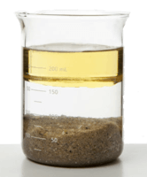
In this Smart Lesson you will learn:
• | That matter can be classified according to several properties.
• | That one way of classifying matter is based off how chemicals are distributed within a substance.
• | Properties of materials can be classified as chemical or physical.
• | That reactions and changes in substances can also be chemical or physical.

Slide 3
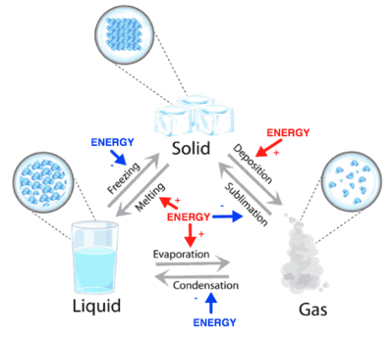
You will have seen previously that matter can be broadly divided into three states: solid, liquid and gas.
However this cannot classify all matter, particularly when a substance is a mixture of various chemicals or particles such as sand or mud.

Slide 4
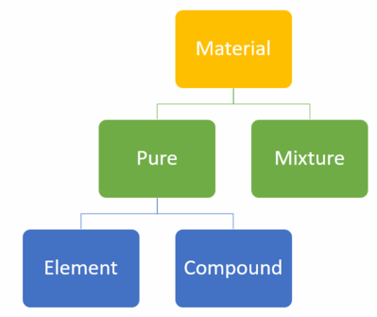
Materials are either pure substances (elements or compounds), which have distinct measurable properties, such as melting point, boiling point, reactivity, strength and density, or are mixtures, with properties dependent on the identity and relative amounts of the substances that make up the mixture.

Slide 5
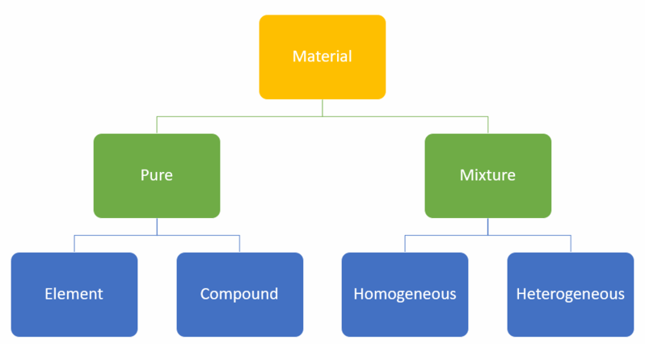
Most of what we see around us is made from multiple elements and compounds physically combined, rather than pure substances.
These mixtures can be divided into two categories based on the way substances are distributed within them. If chemicals are distributed uniformly and evenly then the substance is called homogeneous, however if chemicals are unevenly distributed then the substance is heterogeneous.

Slide 6
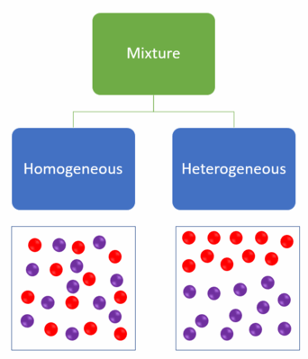
Examples of homogeneous mixtures are solutions such as salty water, and colloids such as milk or fog. In these mixtures the components are distributed evenly.
Examples of heterogeneous mixtures are an oil and water mixture, clouds in the air, or beach sand. In these mixtures the components are NOT distributed evenly.

Slide 7

The characteristics of a material can be divided into physical properties and chemical properties.
A physical property is a characteristic of a substance that can be determined without needing to undergo a chemical reaction, for example boiling and melting points, density, conductivity, colour etc...
Physical properties are dependent upon the composition of the material, for example the higher the salt content of salt water the denser it becomes.

Slide 8
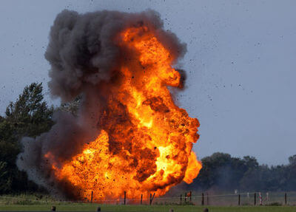
A chemical property is related to how a substance will undergo reaction to form new compounds, for example if it is flammable, sensitive to light or reactive with regard to another substance (water, acids, metals etc...).
A chemical property can only be identified through experimentation. If we wanted to know if a chemical is flammable the easiest way is to try set it on fire!
11 of 25

Slide 9
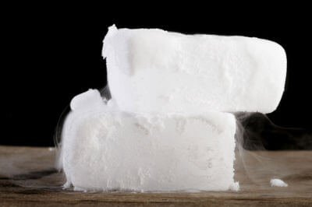
Materials can also undergo changes that can be classified as physical or chemical changes.
A physical change does not involve a change in the composition of a material, only its physical state changes. An example of a common physical change is a change in state or phase such as melting or boiling, or even sublimation (solid to gas).

Slide 10
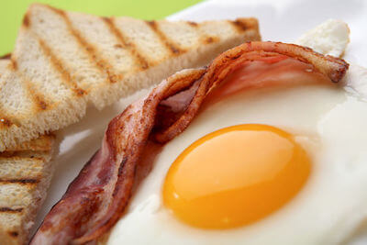
A chemical change involves alteration of the chemical composition of a material by reacting it with other chemicals.
For example frying an egg causes the egg to become more solid when heated. This is because it alters the chemical structure rather than the energy between particles, as is usually the case when a substance is heated.

